Slide 1
All My Sons
By Arthur Miller
Maya Toledano

Slide 2
Points for discussion
How would you define a responsible person?
Are you a responsible person? Why or why not? Give examples of people you know in your personal life or in the public domain who are responsible. How do these individuals support your definition?
How does one learn to become a responsible person?
Who are the "teachers" and where do we find them in our lives?
Is being responsible a character trait that you value a lot?
Why or why not?
"Do unto others as you would have others do unto you." What does this statement mean?

Slide 3
SITUATION
A young man's older brother is believed to be dead, but there is no real proof, because his body has never been recovered. Despite the fact that he has been missing for at least five years, since his plane was shot down, the young man's mother is still waiting for her son to return. As far as she is concerned, her son - a war hero who received medals from the Department of Defense for his contributions to the war effort - is still alive. The father of the two brothers has resigned himself to the tragic loss of his son. He and his younger son are currently in business with each other.
Before the accident, the older brother had a girlfriend whom he expected to marry. When the accident was reported, the girlfriend moved to another state. For the past year the young man has been corresponding with his brother's former girlfriend, and they have fallen in love with each other, and would like to get married. The girlfriend has come back for the first time since the accident to visit the family.

Slide 4
A Play
A Short Story

Slide 5



Slide 6



Slide 7
I. Setting:
1. Where does the play take place?
a. _________________________________________
b._________________________________________
2. From the description of the house, what is the family’s socio-economic status? (circle one)
a. poor b. middle class c. rich
3. When does the play take place?
time of day:_______________________________
day:_____________________________________
month:___________________________________
year:____________________________________
II. Stage:
Draw the stage as you understand it to look. Write in the 6 objects you are given in their places on stage, as it was described in the opening segment.

Slide 8
Objects on stage
trellised arbor
driveway
stump of apple tree
garbage pail
poplar trees
house
upstage
stage left
stage right
downstage

Slide 9
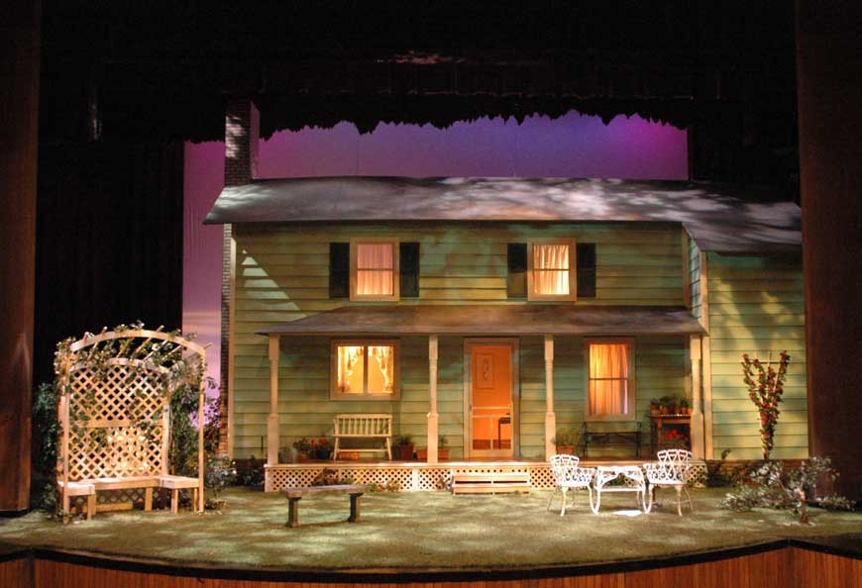

Slide 10
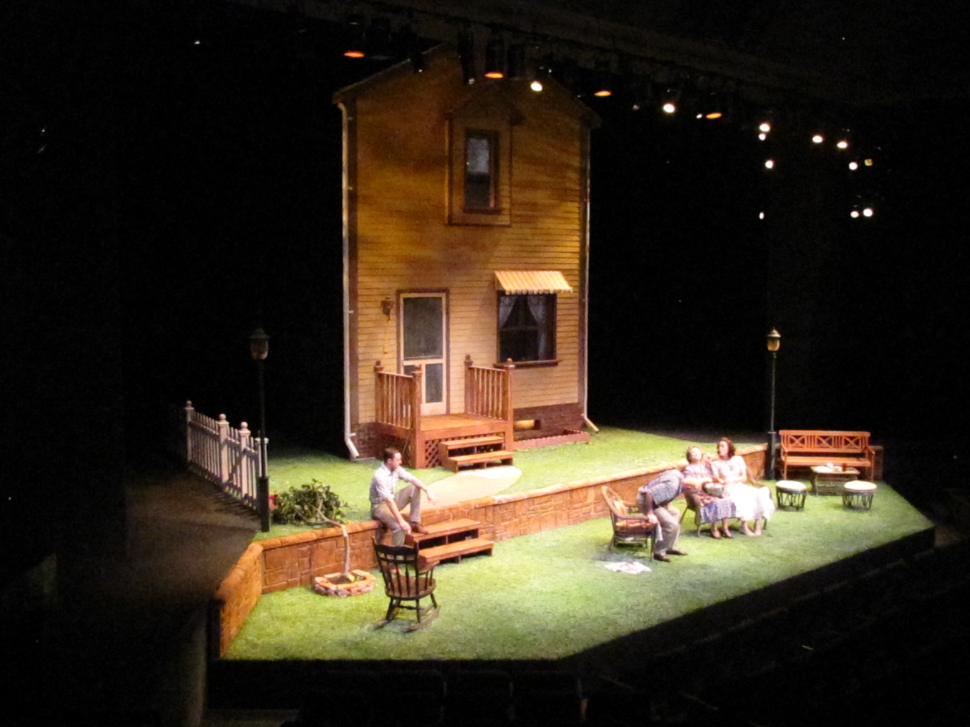

Slide 11
The Kellers
The Deevers
Neighborhood child
The Baylisses
The Lubeys

