Slide 1
All my sons
Bridging Text and Context by Ayelet Raz

Slide 2
All my sons – Is it based on a true story?

Slide 3
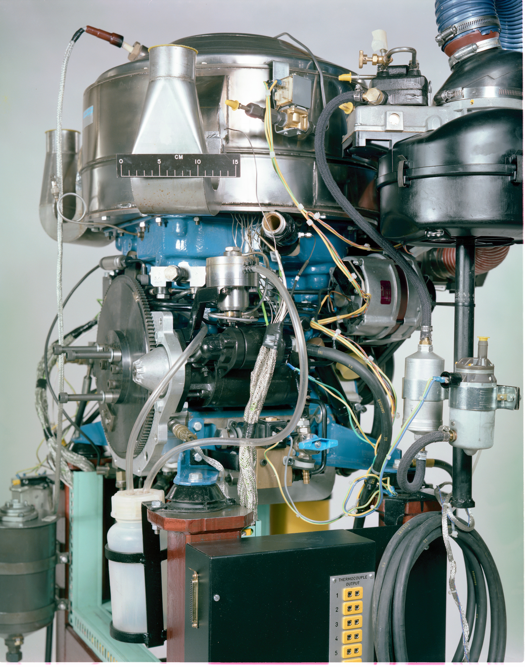
The real story behind it
All My Sons – Is It Based on a True Story?
All My Sons is based upon a true story, which Arthur Miller’s
then mother-in-law pointed out in an Ohio newspaper. The news story described how in 1941-43 the Wright Aeronautical Corporation based in Ohio had conspired with army inspection officers to approve defective aircraft engines destined for military use.
The story of defective engines had reached investigators working for Sen. Harry Truman's congressional investigative board after several Wright aircraft assembly workers informed on the company; they would later testify under oath before Congress.[In 1944, three Army Air Force officers, Lt. Col. Frank C. Greulich, Major Walter A. Ryan, and Major William Bruckmann were relieved and later convicted of neglect of duty.

Slide 4
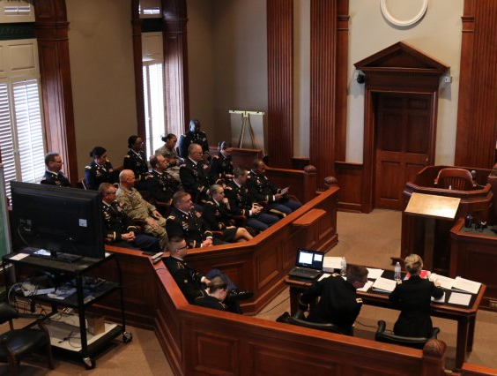
THE TRIAL
Bond later testified that he
had been "wined and dined" by
Wright company officials. In 1944,
three Army officers, were charged with
neglect of duty
conspiracy
giving false testimony in a general court martial
All three men were later convicted of neglect of duty.
Arthur Miller's play All My Sons is based on this incident

Slide 5
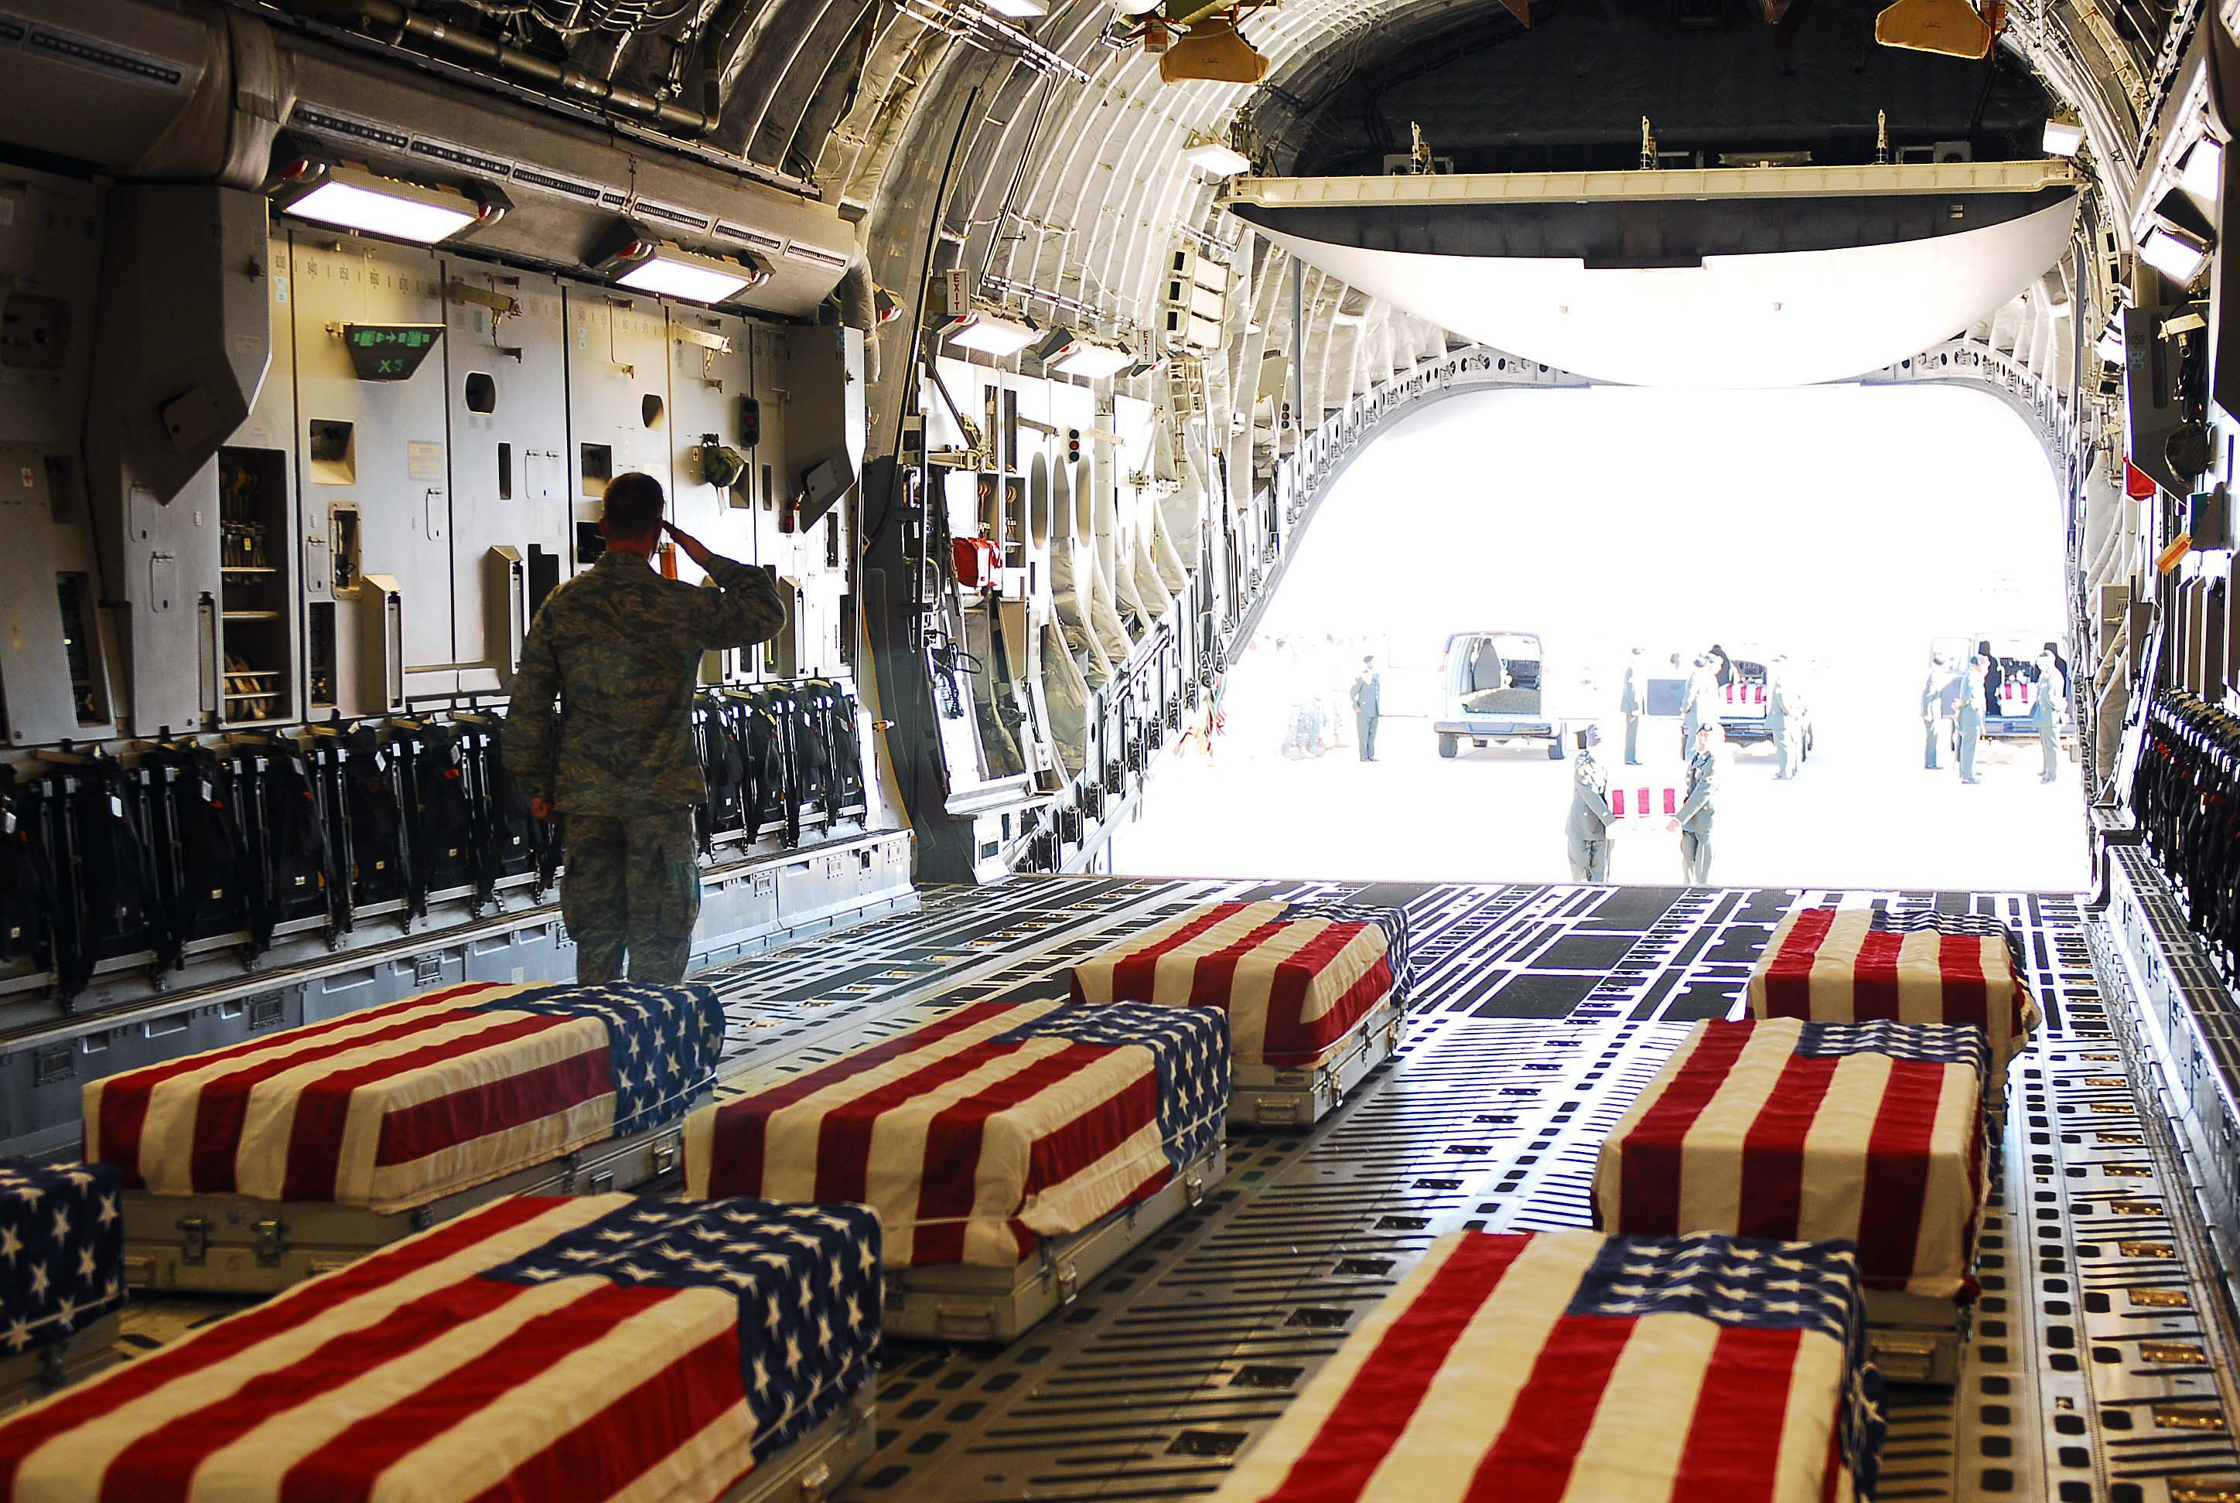
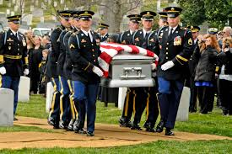
A story of one of the pilots who crashed
In 2011, columnist Richard J. Eskow columnist for the Huffington Post, alleged that his uncle Jack Temple “died in World War II.
Temple’s death in a military bomber crash was allegedly tied to engine failure due to improper manufacture and/or assembly.
The engines had passed inspection even though they were defective.
Anderson had alleged that Curtiss-Wright “had sold leaky motors to the government and covered it up with forged inspection reports.” As a result of the investigation, wrote Anderson, “heads rolled at Curtiss-Wright and one general wound up in prison

Slide 6
“keller’s” company
Curtis Wright Company Then…
http://en.wikipedia.org/wiki/File:Curtiss-Wright
The Wright brothers- What do you know about them?

Slide 7
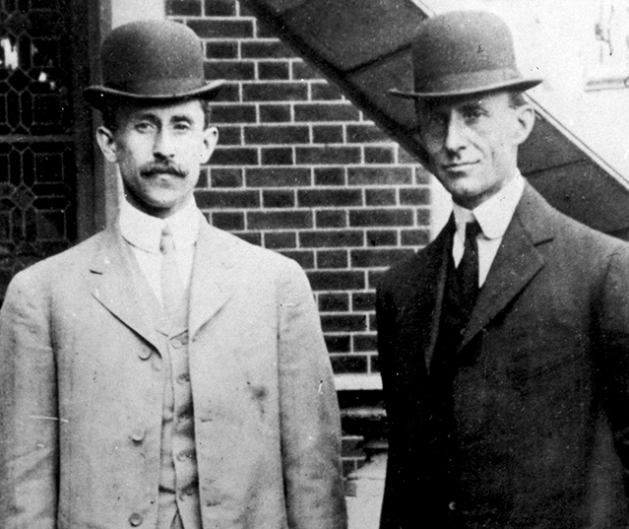
Wright Brothers
Wilbur and Orville Wright were American inventors and pioneers of aviation. In 1903 the Wright brothers achieved the first powered, sustained and controlled airplane flight; they surpassed their own milestone two years later when they built and flew the first fully practical airplane.

Slide 8
WHAT DO YOU THINK HAPPENED TO THE REAL LIFE KELLER’S COMPANY?
Do they still exist after this?

Slide 9
Let’s find out….
http://www.curtisswright.com/markets/commercial-aerospace/default.aspx
http://www.curtisswright.com/company/history/default.aspx
Curtis Wright Company today
https://en.wikipedia.org/wiki/Curtiss-Wright Notice their revenue
http://www.curtisswright.com/home/default.aspx

Slide 10
A few of curtiss wright products
Boeing
Apache
F- 35

Slide 11
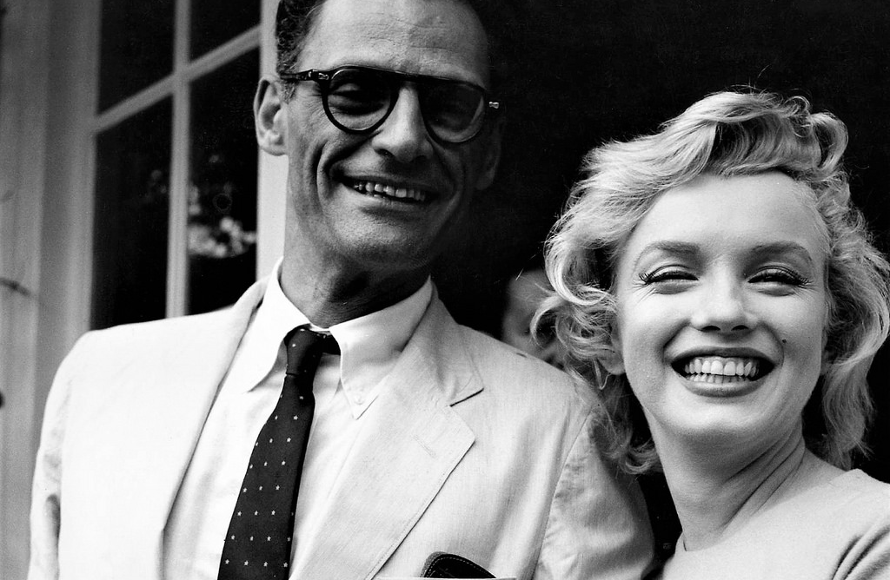
Arthur miller1915-2005
Awards and prizes
About the playwright
University of Michigan Hopwood Award for Creative Writing, No Villain (1936) University of Michigan Hopwood Award for Creative Writing, Honors at Dawn (1937) Theater Guild Award, The Man Who Had All the Luck (1944) Tony Award, All My Sons (1947) New York Drama Circle Critic's Award, All My Sons (1947) Tony Award, Death of a Salesman (1949) Pulitzer Prize, Death of a Salesman (1949) New York Drama Circle Critic's Award, Death of a Salesman (1949) Tony Award, The Crucible (1953) Honorary degree, University of Michigan (1956) John F. Kennedy Award for Lifetime Achievement (1984) Emmy, Playing for Time (1980)
Arthur Asher Miller ,one of the greatest American playwrights of his time who combined social awareness with a searching concern for his characters’ inner lives. Salman Rushdie once called Miller "a man of true moral stature, a rare quality in these degraded days." Miller was shaped by the Great Depression, which brought financial ruin onto his father, a small manufacturer, and demonstrated to the young Miller the insecurity of modern existence.

Slide 12
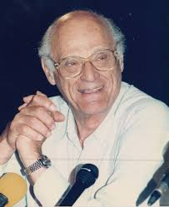
Arthur miller quotes
“Maybe all one can do is hope to end up with the right regrets.”
A suicide kills two people, Maggie, that's what it's for!”"
“Life, woman, life is God's most precious gift; no principle, however glorious, may justify the taking of it.” The Crucible
“I realized what a ridiculous lie my whole life has been.” Death of a Salesman
"A character is defined by the kinds of challenges he cannot walk away from. And by those he has walked away from that cause him remorse.”
“Now remember what the angel Raphael said to the boy Tobias. Remember it. 'Do that which is good,and no harm shall come to thee.”
“Until an hour before the Devil fell, God thought him beautiful in Heaven.” The Crucible
“Don't be seduced into thinking that that which does not make a profit is without value.”
Source: http://classiclit.about.com/od/millerarthur/a/aa_amillerquote.htm
Source: http://www.goodreads.com/author/quotes/8120.Arthur_Miller?page=2

Slide 13
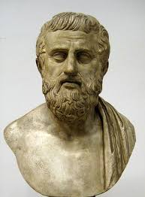
The Greek tragedy elements in the play
Arthur Miller's writing in All My Sons often shows great respect for the great Greek tragedies.
In these plays the tragic hero or protagonist will commit an offense, often unknowingly, which will return to haunt him, sometimes many years later.
The play encapsulates all the fallout from the offense into a 24-hour time span. During that day, the protagonist must learn his fate and suffer as a result, and perhaps even die.
In this way the gods are shown to be just and moral order is restored.
In All My Sons, these elements are all present; it takes place within a 24-hour period, has a protagonist suffering from
a previous offense, and the punishment for that offense.
Additionally, it explores the father-son relationship,
also a common theme in Greek tragedies.

Slide 14
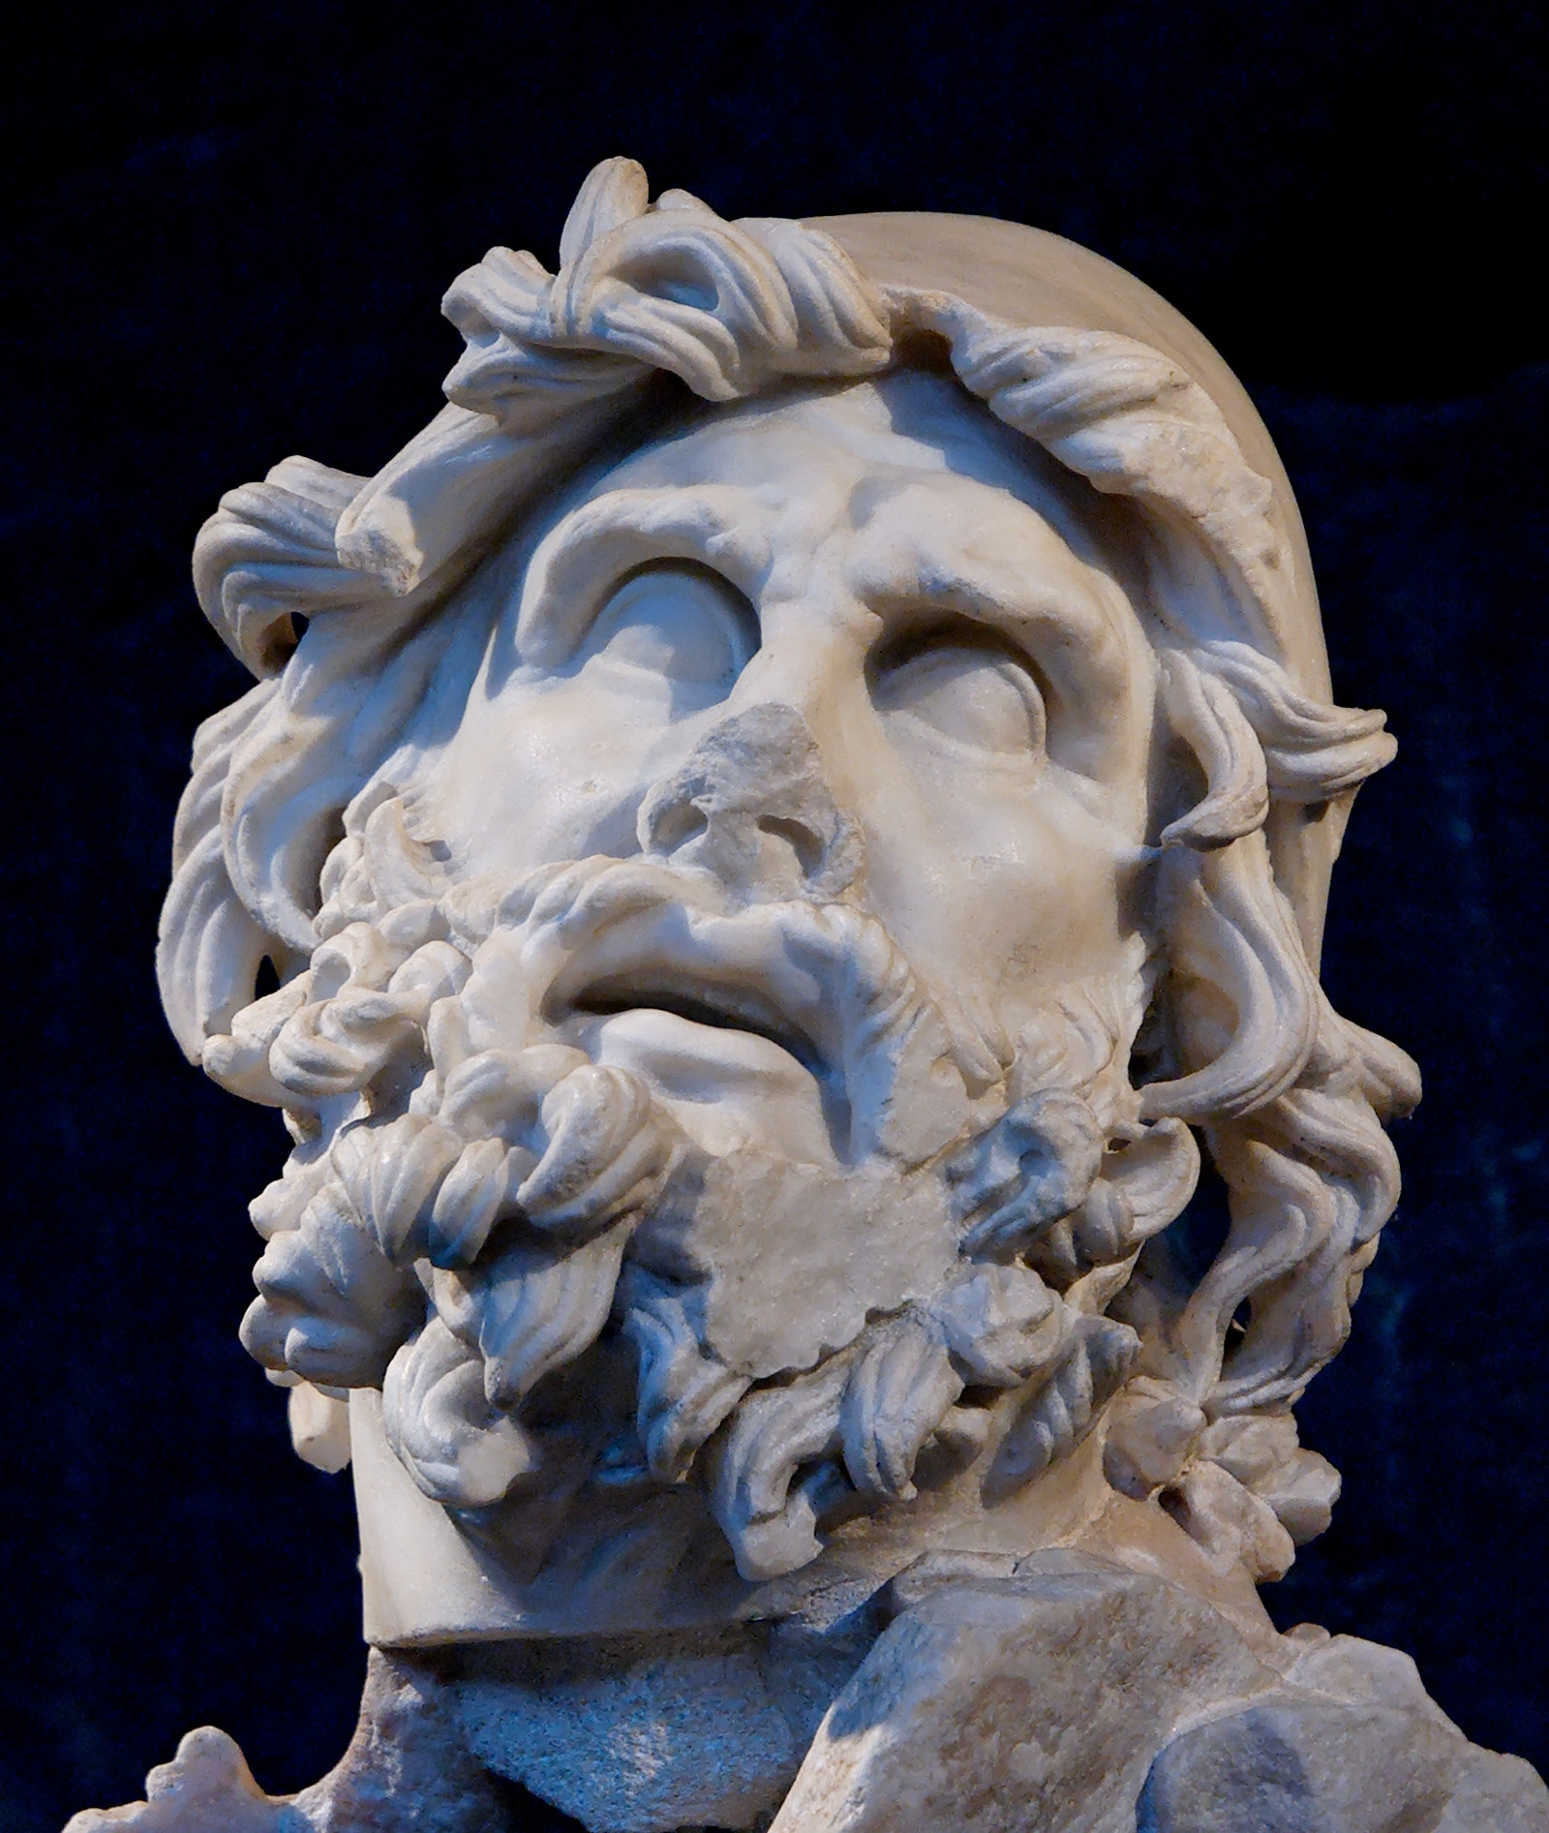
In the Greek Tragedy there is often a messenger – someone who delivers bad news that will change the character’s life forever.
Ann Deever could also be seen to parallel a messenger as her letter is proof of Larry's death.
In Joe Keller, Arthur Miller creates just a representative type. Joe is a very ordinary man, decent, hard-working and charitable, a man no one could dislike.
But, like the protagonist of the ancient drama, he has a flaw or weakness.
His weakness is his twisted value system which puts money (and excuses it
for the sake of the family) above all else – even human life!
This, in turn, causes him to act wrongly. He is forced to accept responsibility by….
His suicide is necessary to restore the moral order of the universe, and allows his son,Chris, to live free from guilt and persecution.

Slide 15
sources
https://en.wikipedia.org/wiki/Wright_brothers
http://en.wikipedia.org/wiki/File:Curtiss-Wright_entrance_Cladwell_NJ_1941.jpg
http://www.curtisswright.com/markets/commercial-aerospace/default.aspx
http://www.curtisswright.com/company/history/default.aspx
https://en.wikipedia.org/wiki/Curtiss-Wright
http://www.curtisswright.com/home/default.aspx
http://classiclit.about.com/od/millerarthur/a/aa_amillerquote.htm http://www.goodreads.com/author/quotes/8120.Arthur_Miller?page=2
https://www.google.com/search?q=p+40&source=lnms&tbm=isch&sa=X&ved=0ahUKEwi4qoKtwcPgAhUIGuwKHZ87DQAQ_AUIDigB&biw=1536&bih=674

Slide 16
Thanks for watching
Ayelet Raz

